Slide 1
Clustering Regions in Yogyakarta, Indonesia Based on It’s Region Food Preferences
Rizky Oulia O. P. L.
July 27th, 2020
ouliaopl@gmail.com

Slide 2
Introduction
Yogyakarta is a really diverse place in Indonesia. Food and beverage businesses is one of the most attractive and lucrative market.
Interests: This project is meant to help entrepreneurs, local cooks and chefs to better understand the correlation between the location and the best type of restaurant to be opened based on local palate. By choosing the best location based on the type of restaurant they're going to open, hopefully they could minimize the risk of bankruptcy and maximize profit.
Problems: To better understand the palate preferences in Yogyakarta, foursquare venue data will gives us relevant information about restaurant type and it's location. By using machine learning algorithm such as K-Modes clustering, we can group neighborhoods that have similar food palates based on type of restaurants thus giving us cluster of food preferences.

Slide 3

Data Acquisition and Cleaning
Data acquired are from:
Data retrieved from https://kodepos.nomor.net/_kodepos.php?_i=kota-kodepos&daerah=Provinsi&jobs=DI+Yogyakarta&perhal=400&urut=10&asc=00001111&sby=110000&no1=2 for region names and postal code information.
Geopy library to find geographical location information.
Using Foursquare API to find nearby restaurants information such as their location and types of dishes they sell.

Slide 4
Clusters That Were Obtained Using K-Mode Method
Cluster 1
Noodle House
Vegetarian/Vegan
Fast Food
Comfort Food
Diner
European Restaurant
Bistro
Breakfast
Buffet
Cafe
10th Most Common Restaurant
1st Most Common Restaurant

Slide 5
Clusters That Were Obtained Using K-Mode Method
Cluster 1
Cafe
Vegetarian/Vegan
Street Food
Diner
European
Fast Food
Bistro
Breakfast
Buffet
Comfort Food
10th Most Common Restaurant
1st Most Common Restaurant

Slide 6
Clusters That Were Obtained Using K-Mode Method
Cluster 1
Street Food
Vegetarian/Vegan
Bistro
Diner
European
Fast Food
Breakfast
Buffet
Cafe
Comfort Food
10th Most Common Restaurant
1st Most Common Restaurant

Slide 7
Clusters That Were Obtained Using K-Mode Method
Cluster 1
Cafe
Cafe
Vegan/Vegetarian
Cafe
Comfort Food
European Restaurant
Fast Food
Bistro
Breakfast
Buffet
10th Most Common Restaurant
1st Most Common Restaurant

Slide 8
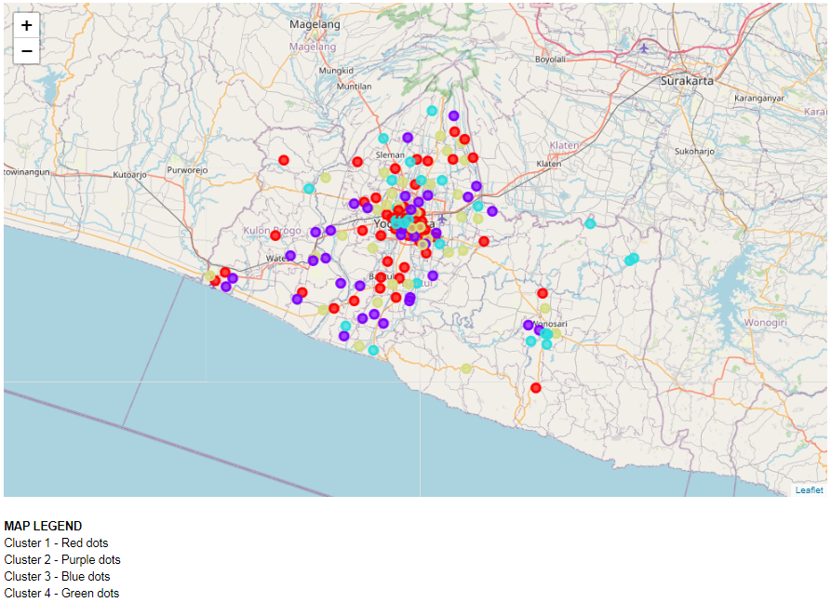
Distribution of Clusters on the Map

Slide 9
Conclusion and Future Directions
Restaurant Reccomendations:
Cluster 1: Types: Bistro, Breakfast Spot, Buffet; Group of People: All; Price: Low-Medium-High Cluster 2: Types: Bistro, Breakfast Spot, Buffet; Group of People: Tourist; Price: Medium-High Cluster 3: Types: Breakfast Spot, Buffet, Cafe; Group of People: Tourists; Price: Medium-High Cluster 4: Types: Fast Food, Bistro and Breakfast Spot; Group of People: Students, Residents; Price: Low-Medium
Future Directions:
This model only gives 62% of accuracy
I think there may be better approaches other than the K-Modes that was used in this study. Furthermore, more data might be the answer since I observed that small and rural regions does not have many data or even worse, no data at all from the Foursquare API.
This study also excluded the frequency/number of restaurants on each region since I only cluster the region by ranking. This may cause overvalue-ing regions with lack of data and undervalue-ing regions with lots of data. And more study about other attributes such as prices and group of people is needed to better understand the clustering. Since the foursquare API have limited access to such data, I did not include it in the study.

